Slide 1
Rock, Paper, Scissors
JavaScript Coding Game Project
© Tech Twins, LLC. All Rights Reserved.

Slide 2
Directions:
Save As: RockPaperScissors.html
Objective: You will practice coding a game with the JavaScript with the knowledge you have previously learned. The game you create will have the user play the computer in a rock, paper, scissors game. Follow the instructions below to get started. Always refer to previous coding lessons and the Coding Cheat Sheet when you need help.
Directions:
During this project, you will be working in a group, waiting for your teacher's instructions on the group assignments.
You are to create a new file for this game project. Title the file as "RockPaperScissors.html."
After all documents are saved, run and debug your coding on the internet so you can check your work.
Save when you are done with your student drive.

Slide 3
Game Rules
You will code a game to have players play rock, paper, scissors against the computer.
Requirements:
Create the HTML structure for the game, including three buttons to submit the guess, and a display area for game result messages.
You will not use a coding answer key for this project. To see how the game's final product should look, you can glance at the next slide to have a visual.
Try your best as a group to code your game accurately.
Please remember that your coding/ website view can differ from what is shown on the next slide.

Slide 4
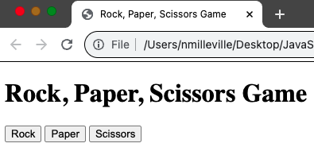
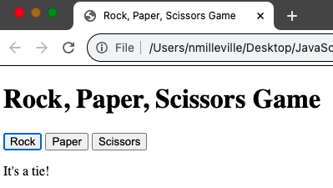
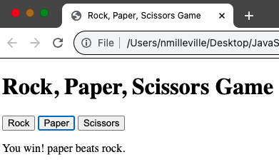
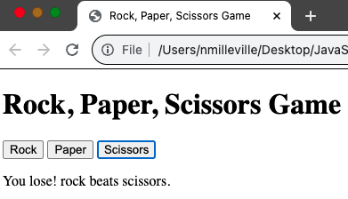
Rock, Paper, Scissors- Website View

Slide 5
Coding Key
Insert Picture Here
Share your coding key on this slide.

Slide 6
Website View
Insert Picture Here
Share your website view on this slide.

Slide 7
Rock, Paper, Scissors Project Rubric
Name___________ | Exceeds Expectations 10-8 | Meets Expectations 7-5 | Developing 4-0
HTML structure for the game Title Header Script
Included three buttons to submit the guess
A display area for messages about game results
Student was on task, worked well with their group, and work was submitted on time.
Comments: |  | Total Points: ___/40

